Slide 1
Chapter 12: Advanced topic Web 2.0

Slide 2
Contents
Web 2.0
DOM
AJAX
RIA

Slide 3
Web 2.0
"Web 2.0" refers to the second generation of web development and web design that facilities
  information sharing,
  interoperability,
  user-centered design
  collaboration on web.
Web 2.0 does not have any technical update specifications
Web 2.0 refers to cumulative changes in the ways software developers and end-users utilize the Web
  User create web contents
  Users can own the data and exercise control over that data
Ex: social-networking sites, video-sharing sites, wikis, blogs, google maps…

Slide 4
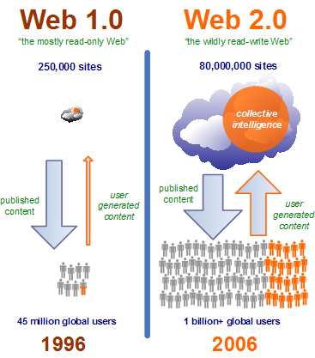

Slide 5
Web 2.0 vs. Web 1.0
Web 1.0 | Web 2.0
collective | dispersed in many places
for individuals | for society, collective wisdom
provide content | provide services and APIs
readable | writable
communication between systems | synchronization between systems
the system includes structure, the content generated is pre-calculated | auto-generate and auto-suggest

Slide 6
Example of the move to Web 2.0
Web 1.0 --> Web 2.0
  Ofoto --> Flickr
  Akamai --> BitTorrent
  mp3.com --> Napster (users share file)
  Britannica Online --> Wikipedia (users create content)
  personal websites --> blogging
  domain name speculation --> search engine optimization
  publishing --> participation

Slide 7
DOM
The Document Object Model (DOM)
  platform- and language-independent
  standard object model for representing HTML or XML documents
DOM provides an API for querying, traversing and manipulating such documents
It defines the logical structure of documents and the way a document is accessed and manipulated.
  programmers can build documents, navigate their structure, and add, modify, or delete elements and content of HTML and XML
  DOM uses objects to model elements of documents.
XML presents data as documents, and the DOM may be used to manage this data.
DOM is a model and is implemented in different language: Javascript, VBscript, Java…

Slide 8
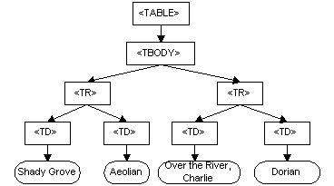
DOM
The DOM model of a document resembles closely the structure of the document.
Ex:
<TABLE>
<TBODY>
<TR>
<TD>Shady Grove</TD>
<TD>Aeolian</TD>
</TR>
<TR>
<TD>Over the River, Charlie</TD>
<TD>Dorian</TD>
</TR>
</TBODY>
</TABLE>
DOM representation

Slide 9
DOM
DOM currently consists of two parts
  DOM Core
    represents the functionality used for XML documents
    serves as the basis for DOM HTML
    A compliant implementation of the DOM must implement entirely the Core and implement at least one of the HTML DOM and the extended (XML) interfaces
  DOM HTML.
    Model for HTML document
      Document, form, button, etc…
Example of programming with DOM
  See the textbook

Slide 10
Ajax
Ajax = Asynchronous JavaScript and XML,
A group of interrelated web development techniques used on the client-side to create interactive web applications or rich Internet applications.
With Ajax, web applications can retrieve data from the server asynchronously in the background without interfering with the display and behavior of the existing page.
  reduce bandwidth usage and load time
  increase interactivity and dynamicity on web pages
  → better quality of Web services
Data is usually retrieved using the XMLHttpRequest object.
Despite the name, the use of JavaScript and XML is not actually required, nor do the requests need to be asynchronous.

Slide 11
History of Ajax
199x: Techniques for the asynchronous loading of content is introduced with Java applets
1996, Internet Explorer introduced the IFrame element to HTML, which also enables this to be achieved.
1999, Microsoft created the XMLHTTP ActiveX control in Internet Explorer 5 using the native XMLHttpRequest object.
However, this feature only became widely known after being used by Gmail (2004) and Google Maps (2005).
The term "Ajax" itself was coined in 2005

Slide 12
Ajax technology
Uses XHTML and CSS for presentation
Uses DOM for dynamic display of and interaction with data
Uses XML and XSLT for the interchange, and manipulation and display, of data, respectively
Uses XMLHttpRequest object for asynchronous communication
Uses JavaScript to bring these technologies together
However
  Other languages such as VBScript can also replace JavaScript in Ajax
  XML, XSLT are not required for data interchange and manipulation. JavaScript Object Notation (JSON) is often used as an alternative format for data interchange. Other formats such as preformatted HTML or plain text can also be used

Slide 13
Drawbacks of Ajax
Pages dynamically created using Ajax requests do not automatically be registered to the browser's history engine
  "back" button may not return the user to an earlier state of the Ajax-enabled page
Dynamic web page updates also make it difficult for a user to bookmark a particular state of the application.
Most web crawlers do not execute JavaScript code → it is impossible for search engine to index page that content is retrieved with Ajax,
Browsers, devices such as mobile phones, PDAs, and screen readers that do not support Ajax or JavaScript will not be able to use its functionality.
Ajax opens up another attack vector for malicious code that web developers might not fully test for

Slide 14
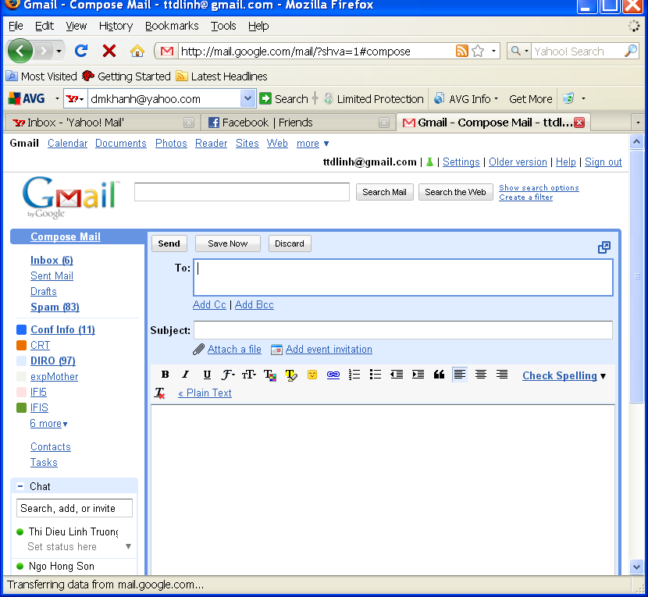
Example of Ajax
Pages using Ajax
  Gmail:
    Read or writing an reply email does not require to reload the page
  News site
    Play video without reload page

Slide 15
RIA
Term RIA was introduced in March 2002 by vendors like Macromedia
Rich Internet applications (RIAs)
  Web applications with most of the characteristics of desktop app.
  Run by using web browser plug-ins, sandboxes or virtual machines.
    sandbox is a security mechanism for separating running programs. Often used to execute untested code, or untrusted programs.
RIA platform:
  Adobe Flash/Adobe Flex/AIR: 99%
  Java/JavaFX: 80%
  Microsoft Silverlight: 54%
Example of RIA:
  Using plug-in : flash : YouTube
  offline usage : Adobe AIR, Google gears : ?

Slide 16
RIA
Rich internet applications use a distributed-function model rather than the simple thin-client–server mode
Flash, Silverlight and Java enrich user experiences in part due to their reduced reliance on network/server communications
  --> reduce response time
Challenge for search engines because RIA content is difficult to be indexed

